Slide 1

Biodiversity for the National Parks
Capstone Project 2
V.Y. 3/2/18

Slide 2

Description of species_info.csv
Species_info.csv contains data about different species in our National Parks:
4 columns in this file:
Category
Scientific name
Common names
Conservation status
7 unique species in this file:
Mammal
Bird
Reptile
Amphibian
Fish
Vascular Plant
Nonvascular Plant
Total of 5541 different species in the data frame.

Slide 3
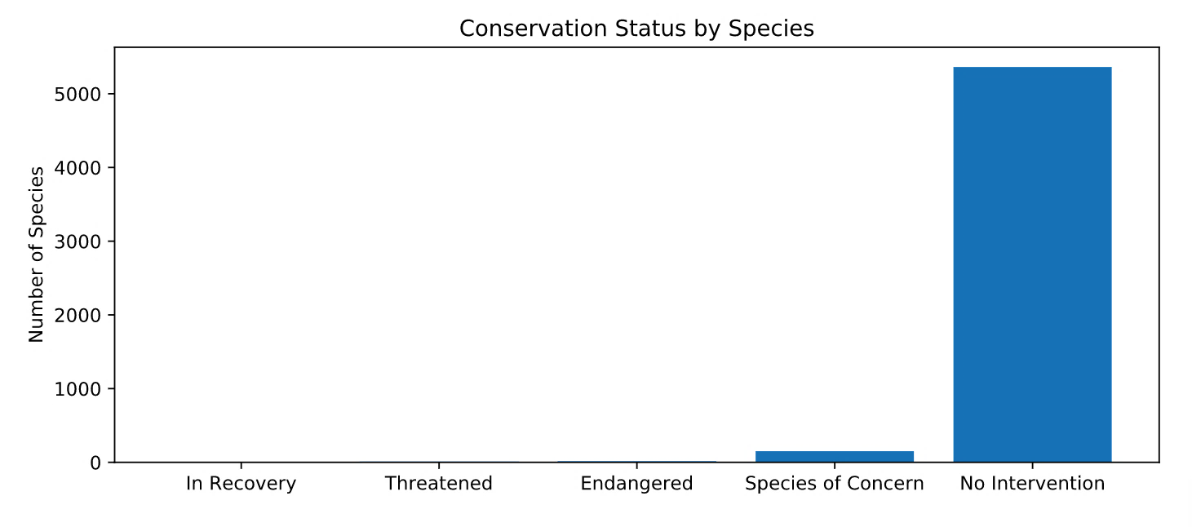
Species Listed in Conservation Status
15 species are endangered and seriously at risk of extinction
4 species are in recovery and not in danger of extinction
151 species are declining population and appears to be in need of conservation
10 species are threatened and vulnerable to endangerment in the near future
However over 5000 species require no intervention!

Slide 4

Investigation and Recommendations for Endangered Species
Combing through the endangered species file, are there certain types of species more likely to be endangered?
Birds have a protection percentage of 15% while Mammals are at 17%; there is not a big significant difference.
When comparing Mammals to Reptiles, where Reptiles have a protection percentage of 6.4%, there seems to be a significant difference.
But is the difference between Reptile and Mammal significant? Using the Chi-Squared Test, it states that there is a significant difference between two of the datasets if the p-value less than 0.05. Here the p-value is only 0.0384, hence not a significant difference.
Mammals and Birds are more protected but still conservationists should nonetheless improve that percentage, all while concentrating on increasing the protection for Reptiles and the other endangered species.

Slide 5
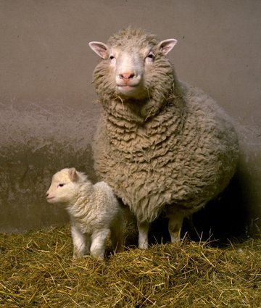
Foot and Mouth Disease Study
The Yellowstone National Park have a program to reduce the rate of foot and mouth disease at the park. For scientists to test whether or not the program works, they want to detect reductions of at least a 5 percentage point. Last year 15% of sheep at Bryce National Park had foot and mouth disease.
Baseline percentage of sample size determination = 15%
Minimum Detectable Effect = 33.33
Level of significance = 90%
Sample Size per Variant = 510
Scientists will need to spend 1 week at Yellowstone National Park to observe enough sheep; and 2 weeks at Bryce National Park.

Slide 6
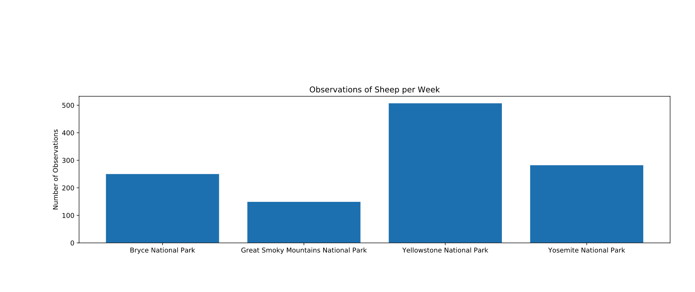
Sheep observation data - number of sightings at each of the four national parks under investigation

Slide 7


